Slide 1

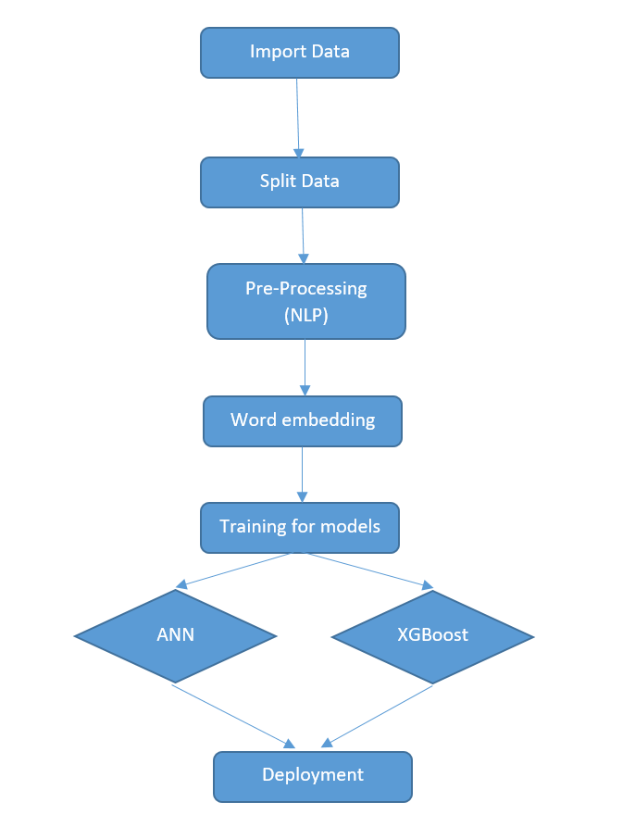


Amazon Reviews Prediction By: Mohanad Mohamed Supervisor: Dr. Nermine Othman
Problem
Users who are using online shopping such as Amazon are distracted when reading other customers reviews on the product that they are willing to buy. Also Amazon employee's want to know from users reviews if the product is good or not to take decision whether remove or keep displaying the product.
System Design/ Interface
Results
“A Review of Stock Market Prediction with Artificial Neural Network (ANN)” is a paper released this year using ANN, scoring the accuracy of 96.7%. Regarding My Review Prediction using ANN model, the accuracy was 98.59%
Contribution.
In attempt to score the highest accuracy, My Artificial Neural Network model scored the highest accuracy. Also, the Xgboost model got relatively high accuracy in comparison with other algorithms.

